Slide 1
SACAIR Hackathon
Sub heading

Slide 2
Program Schedule
Ideate
Collaborate
Design
Develop
Pitch

Slide 3
What is a Hackathon
What are we doing with this one?

Slide 4
How do we deal with data in industry?
Project lifecycle
Data gathering, warehousing and engineering
Analysis and modelling
Serving and visualization

Slide 5
Requirements
Problem statement
Design
Development / Modelling
Reporting
Presentation

Slide 6
Problem statement
Explore the dataset. Decide on which problem you are trying to solve.
Choose a problem to solve / what is valuable in the information that you can show?

Slide 7
Design
Give a basic process flow from source data to front-end reporting. You can give a high-level view of this flow.
Solution design. Think about how data is ingested into a system
Is it streamed in, is it compiled from various datasets and manually created, is it obtained from an API such as the weather service?
Given the problem you want to solve, or valuable info you want to share, how would you store the data?
Would you store it in a cloud service provider, local data center?
How and where would you process it?
Cloud provider? Which service would you use? What processing would you do to solve your problem.

Slide 8
Development / Modelling
Identify the dependent and independent variables in what you are trying to represent.
Find correlations between the variables.
Identify the most appropriate model to solve the problem. Build it.
Of course, you will not be able to build an end-to-end solution. Refer to the assessment criteria for guidance as to what we will be judging the projects on.

Slide 9
Reporting
Display the results in an informative, creative and professional way.
How would you show the results?
Reporting? Which tools? Power BI, QlikView, Notebooks with Matplotlib.

Slide 10
Presentation
PowerPoint? Elevator Pitch presentation to us?

Slide 11
Data Set
Eskom Dataset
Eskom generation supply and demand data
Date Range: 2019/01/01 – 2023/11/15
Eskom Carbon Emissions Data
Date Range: 2020/04/30 – 2023/10/31
Weather data for the following regions:
Johannesburg Durban
Pretoria Port Elizabeth
Cape Town Bloemfontein
Upington

Slide 12
Judging Criteria
Problem statement is well articulated. What are you trying to solve and why? (10%)
Design shows a well considered data flow and processing flow. Ingestion, processing, modelling, reporting (20%)
Modelling of solution. Does the basic prototype work? (40%)
Reporting of results. (20%)
Presentation (10%)

Slide 13
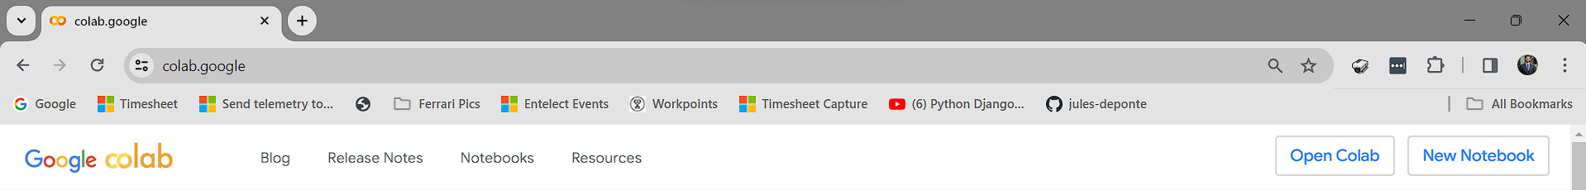
Environment Setup
Coding should preferably be in Python (or R or MATLab?), in a Juypter Notebook. We recommend that you use:
Google Colab:
No local setup necessary. Log into your Google account, go to colab.google, click on New Notebook and start coding.
OR
Local machine
Python, with a development IDE, such as VS Code, Jupyter Notebooks

Slide 14
Code Repository

Slide 15
Dataset detail
Eskom Generation Dataset
Data is supplied at an hourly granularity.
Data about Eskom power demand, energy generation and capacity (MW), averaged over an hour interval.
Energy generation by generation/supply type (international imports, coal, gas, open cycle gas turbine, hydro electric)
Installed generating capacity
The rated energy generation capacity by generation type.
Outages
The various types of outages that contribute to load shedding (these outages are described in the data dictionary)
Energy consumption by power plants used to generate power (referred to as Synchronous Condenser Operation. A technical understanding of this is not needed; a basic description is given in the data dictionary).

Slide 16
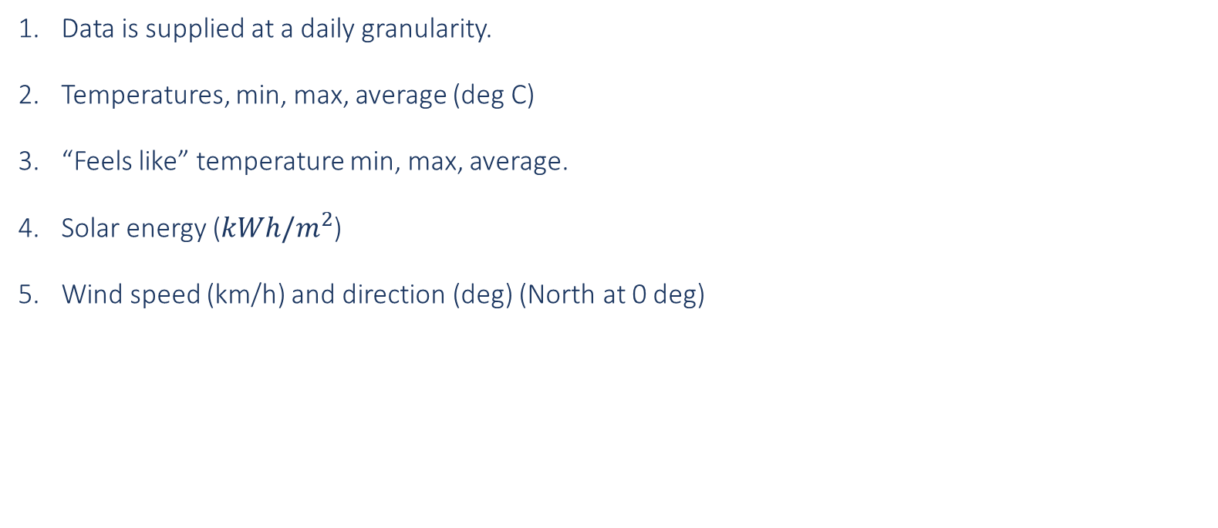
Dataset Detail
Weather Data
Data is supplied at a daily granularity.
Temperatures, min, max, average (deg C)
“Feels like” temperature min, max, average.
Solar energy ($kWh/m^{2}$)
Wind speed (km/h) and direction (deg) (North at 0 deg)

Slide 17
Dataset Detail
Eskom Carbon Emissions and Date Table
Tons of Carbon per month. This is the lowest level of granularity of data available.
Date table. All of the datasets have a date field in common. All of the datasets can be combined using the date.

